Slide 1

Network Security
Course overview
Dr. Lakmal Rupasinghe
Notes:
SISL

Slide 2
The computer security problem
Lots of buggy software
Social engineering is very effective
Money can be made from finding and exploiting vulns.
Marketplace for vulnerabilities
Marketplace for owned machines (PPI)
Many methods to profit from owned machines
current state of computer security

Slide 3
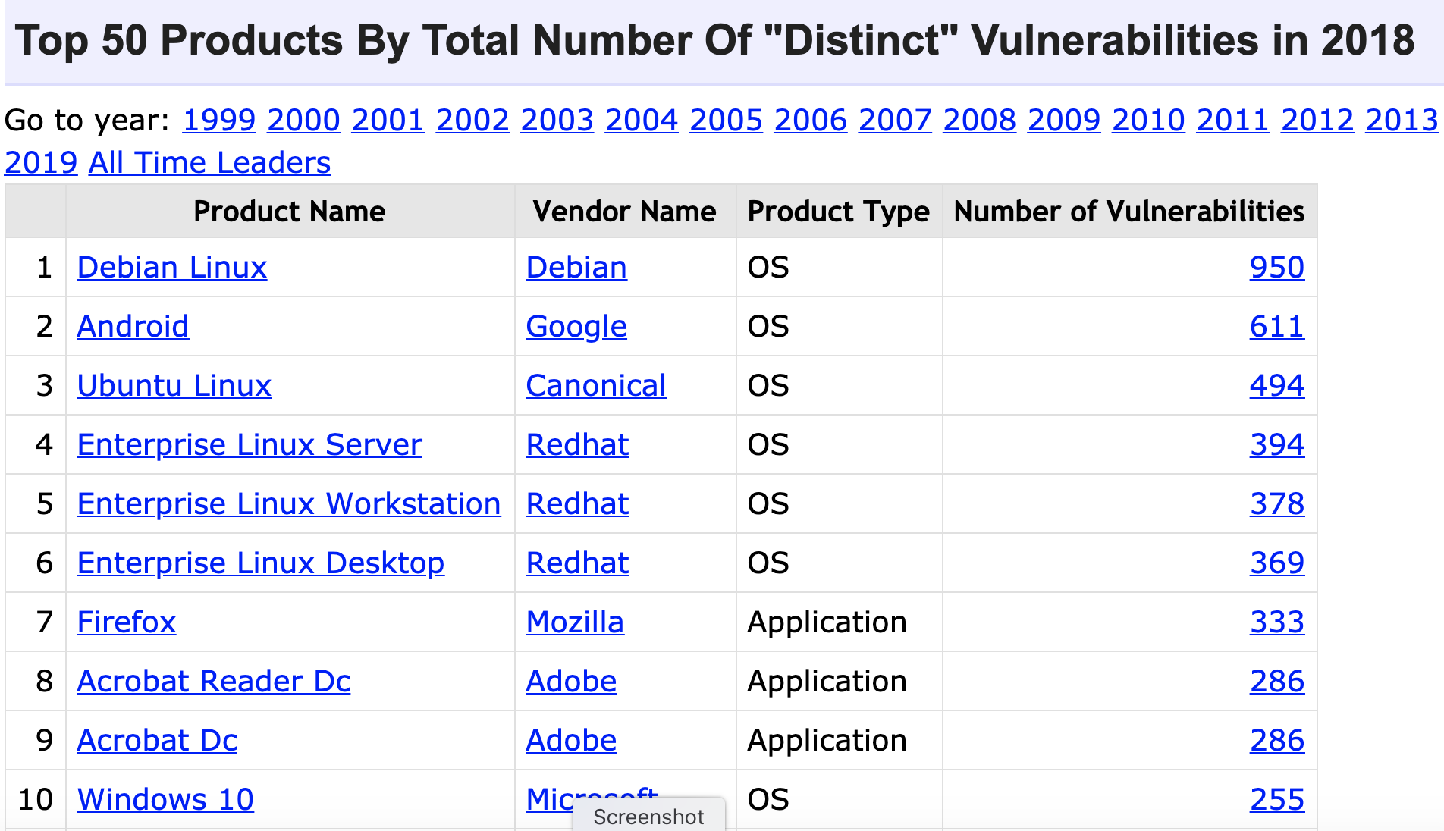
source: https://www.cvedetails.com/top-50-products.php?year=2018
Notes:
Many IoT vulnerability disclosures: so many that MITRE can’t keep up with assigning new CVEs

Slide 4
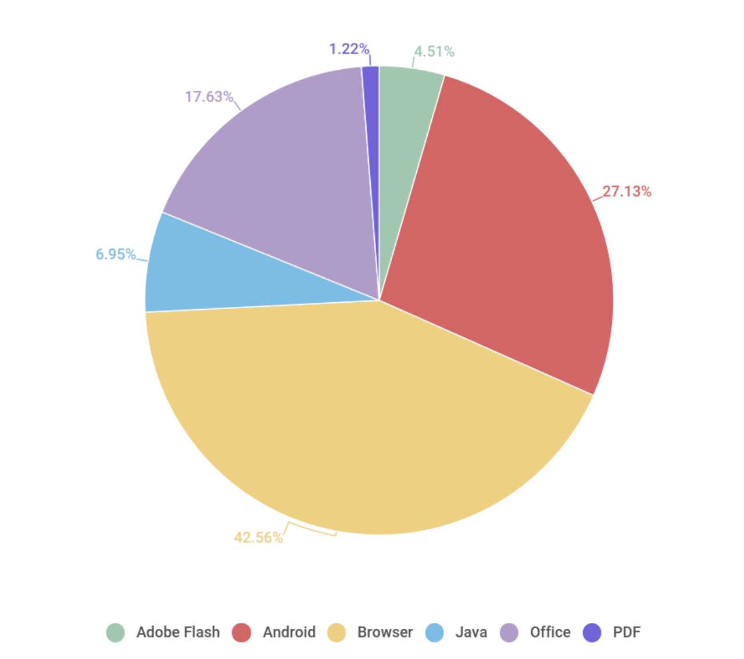
Vulnerable applications being exploited
Office
Java
Android
Browser
Source: Kaspersky Security Bulletin 2017

Slide 5
Sample attacks
Introduction
Notes:
In this segment we will describe a few sample attacks. We will come back to this and discuss malware in far greater detail later on in the course. Here we give a few examples to illustrate the state of the world.

Slide 6
Why own client machines: 1. IP address and bandwidth stealing
Attacker’s goal: look like a random Internet user
Use the IP address of infected machine or phone for:
Spam (e.g. the storm botnet)
Spamalytics: 1:12M pharma spams leads to purchase
1:260K greeting card spams leads to infection
Denial of Service: Services: 1 hour (20$), 24 hours (100$)
Click fraud (e.g. Clickbot.a)
Notes:
DDoS service from hack-shop.org.ru
Source: http://www.defcon.org/images/defcon-15/dc15-presentations/dc-15-holt.pdf
Mobile bot-nets: more reliable because phones are always on

Slide 7
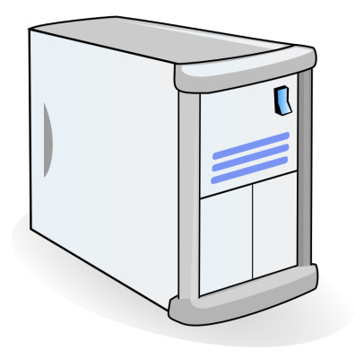


Why own machines: 2. Steal user credentials, crypto miners
keylog for banking passwords, web passwords, gaming pwds.
Example: SilentBanker (and many like it)
User requests login page
Malware injects Javascript
Bank sends login page needed to log in
Bank
When user submits information, also sent to attacker
Similar mechanism used by Zeus botnet
Man-in-the-Browser (MITB)

Slide 8
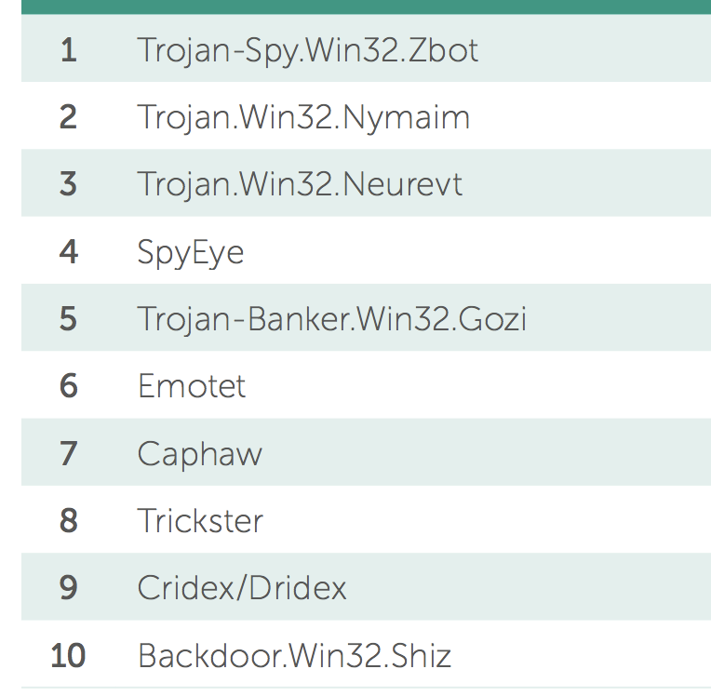
Lots of financial malware
records banking passwords via keylogger
spread via spam email and hacked web sites
maintains access to PC for future installs
Source: Kaspersky Security Bulletin 2017

Slide 9
Users attacked: stats
≈ 300,000 users/month worldwide
A worldwide problem
Source: Kaspersky Security Bulletin 2015

Slide 10
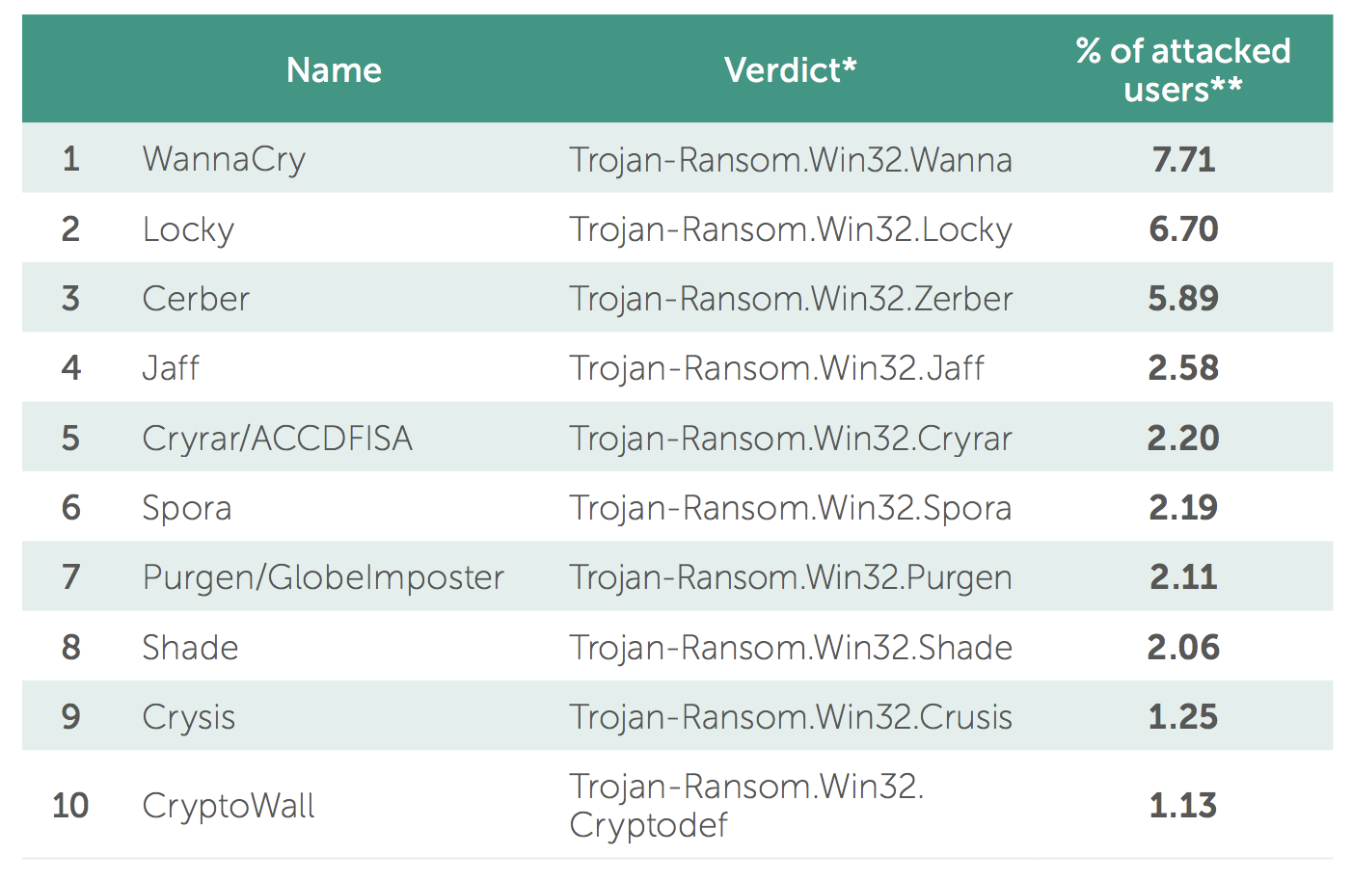
Why own machines: 3. Ransomware
a worldwide problem
Worm spreads via a vuln. in SMB (port 445)
Apr. 14, 2017: Eternalblue vuln. released by ShadowBrokers
May 12, 2017: Worm detected
(3 weeks to weaponize)
Notes:
Good user interface. Bitcoin.

Slide 11
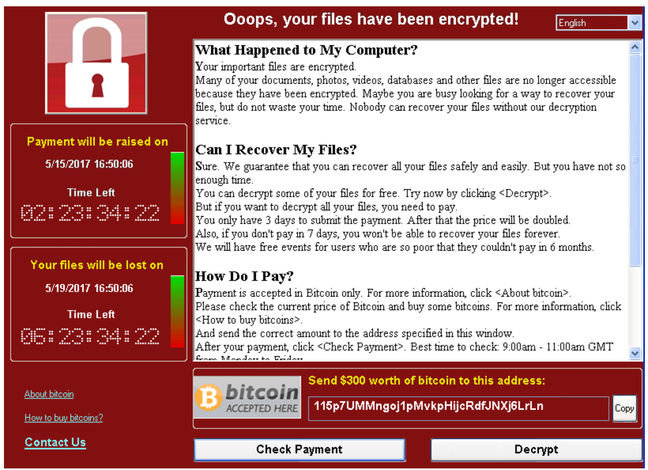
WannaCry ransomware

Slide 12
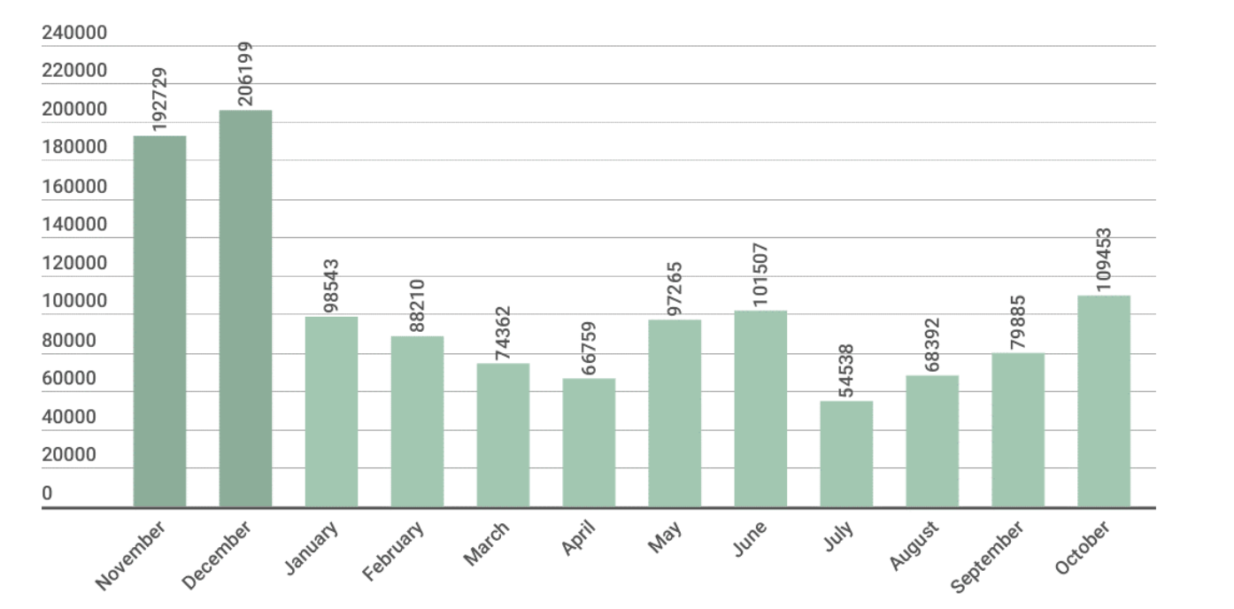
Ransomware in 2017: # users attacked
Source: Kaspersky Security Bulletin 2017

Slide 13
Why own machines: 4. Spread to isolated systems
Example: Stuxtnet
Windows infection ⇒
Siemens PCS 7 SCADA control software on Windows ⇒
Siemens device controller on isolated network
More on this later in course

Slide 14
Server-side attacks
Data theft: credit card numbers, intellectual property
Example: Equifax (July 2017), ≈ 143M “customer” data impacted
Exploited known vulnerability in Apache Struts (RCE)
Many similar (smaller) attacks since 2000
Political motivation:
DNC, Tunisia Facebook (Feb. 2011), GitHub (Mar. 2015)
Infect visiting users
Notes:
Target (2013: 140M CC stolen

Slide 15
Infecting visiting users: Mpack
PHP-based tools installed on compromised web sites
Embedded as an iframe on infected page
Infects browsers that visit site
Features
management console provides stats on infection rates
Sold for several 100$
Customer care can be purchased, one-year support contract
Impact: 500,000 infected sites (compromised via SQL injection)
Several defenses: e.g. Google safe browsing

Slide 16
Types of data stolen (2012-2015)
Source: California breach notification report, 2015

Slide 17
How companies lose data
insider misuse/attack
insider error
malware/hacking
lost/stolen laptops
How do we have this data?
Source: California breach notification report, 2016

Slide 18
Insider attacks: example
Hidden trap door in Linux (nov 2003)
Allows attacker to take over a computer
Practically undetectable change (uncovered via CVS logs)
Inserted line in wait4()
Looks like a standard error check, but …
if ((options == (__WCLONE|__WALL)) && (current->uid = 0))
retval = -EINVAL;
See: http://lwn.net/Articles/57135/

Slide 19
Many more examples
Access to SIPRnet and a CD-RW: 260,000 cables ⇒ Wikileaks
SysAdmin for city of SF government. Changed passwords, locking out city from router access
Inside logic bomb took down 2000 UBS servers
⋮
Can security technology help?
Notes:
SIPRnet = Secret Internet Protocol Router Network
Sysadmin: Terry Childs
Third example: Roger Duronio

Slide 20
The Marketplace for Vulnerabilities
Introduction
Notes:
In this segment I want to tell you about market places that have evolved around exploits and vulnerabilities

Slide 21
Marketplace for Vulnerabilities
Option 1: bug bounty programs (many)
Google Vulnerability Reward Program: up to $31,337
Microsoft Bounty Program: up to $100K
Apple Bug Bounty program: up to $200K (secure boot firmware)
Pwn2Own competition: $15K
Option 2:
Zerodium: up to $2M for iOS, $500K for Android (2019)
… many others
Notes:
There are many people who work on finding vulnerabilities in software, such as Windows or software that runs on top of windows. Finding an explotable vulnerability can take months and the question is what to do when they find one. Most likely they publish an article in a security conference like Blackhat and boost their reputation. But it shouldn’t be too surprising that they can also make money from selling the vulnerability before announcing it at a conference. There are three options.

Slide 22
Example: Mozilla

Slide 23
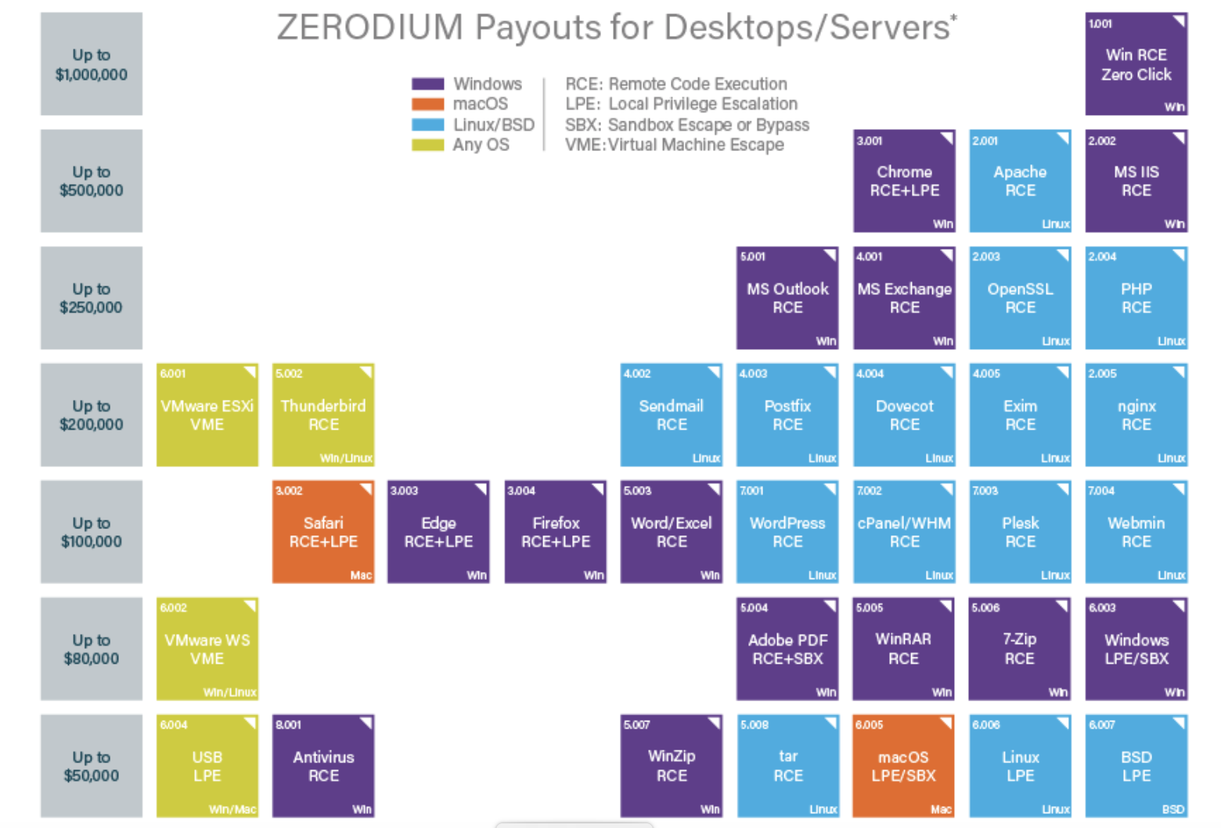
Marketplace for Vulnerabilities
RCE: remote code execution
LPE: local privilege escalation
SBX: sandbox escape
Source: Zerodium payouts
Notes:
Now, the 3rd option is to go to the black market. We don’t quite know the value of vulns. there, but I list here a few quotes that suggest that prices could be higher than with the other two options.

Slide 24
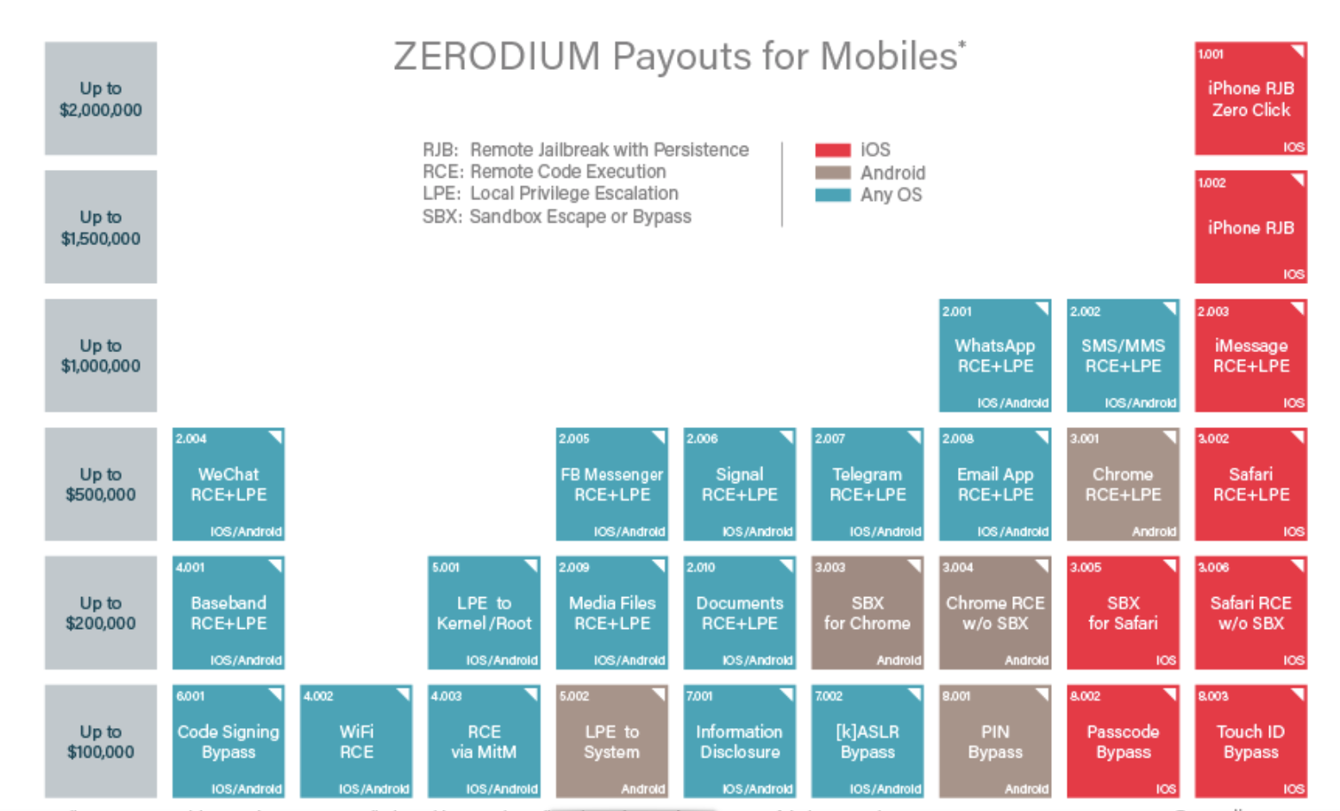
Marketplace for Vulnerabilities
RCE: remote code execution
LPE: local privilege escalation
SBX: sandbox escape
RJB: remote jailbreak
Source: Zerodium payouts
Notes:
Now, the 3rd option is to go to the black market. We don’t quite know the value of vulns. there, but I list here a few quotes that suggest that prices could be higher than with the other two options.

Slide 25
Marketplace for owned machines
Pay-per-install (PPI) services
PPI operation:
Own victim’s machine
Download and install client’s code
Charge client
clients
spam bot
keylogger
PPI service
Victims
Source: Cabalerro et al. (www.icir.org/vern/papers/ppi-usesec11.pdf)

Slide 26
Marketplace for owned machines
clients
spam bot
keylogger
Cost: US - 100-180$ / 1000 machines
Asia - 7-8$ / 1000 machines
PPI service
Victims
Source: Cabalerro et al. (www.icir.org/vern/papers/ppi-usesec11.pdf)

Slide 27
This course
Goals:
Be aware of exploit techniques
Learn to defend and avoid common exploits
Learn to architect secure systems

Slide 28
This course
Part 1: basics (architecting for security)
Securing apps, OS, and legacy code Isolation, authentication, and access control
Part 2: Web security (defending against a web attacker)
Building robust web sites, understand the browser security model
Part 3: network security (defending against a network attacker)
Monitoring and architecting secure networks.
Part 4: securing mobile applications

Slide 29
Don’t try this at home !

Slide 30
Ken Thompson’s clever Trojan

